Slide 1
Taming the Wild World of Immigration with Your U.S. Immigration Knowledge
Kia Baptist, Diamond Offshore
Ryan Chargois, Foster LLP
Andrew Yewdell, Council for Global Immigration

Slide 2
Today’s Presentation
About Us
What’s Going on in the World of Immigration?
Applying Your U.S. Immigration Knowledge
Changing the Status Quo with Advocacy

Slide 3
About Us
CFGI is the leading global employer network dedicated to immigration.
Diamond Offshore is a leader in offshore drilling, providing contract drilling services to the energy industry around the globe.
Foster is a leading immigration law firm delivering the full spectrum of U.S. and global immigration solutions.

Slide 4
3 Drivers of Global Immigration
Around the world we’ve observed increased immigration due to…
Skills Gaps
Globalization
Geopolitical Instability

Slide 5
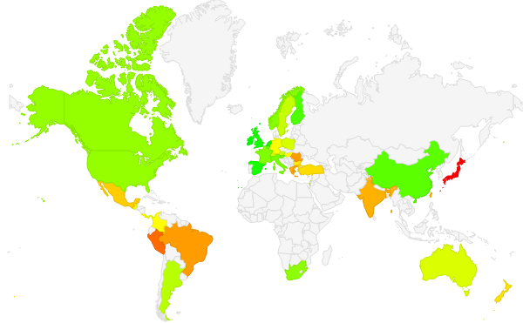
Skills Gaps
Percentage of employers reporting difficulty filling jobs per ManpowerGroup’s 2015 Talent Shortage Survey…
24%
32%
46%
61%
54%
0%
100%
31%
31%
58%
83%

Slide 6
Globalization
With more global operations, employers are moving more talent around the world…

Slide 7
Globalization
…and 86% of employers report that they must obtain visas in a timely, predictable, and flexible manner to meet business objectives. CFGI’s data by size of employer…

Slide 8
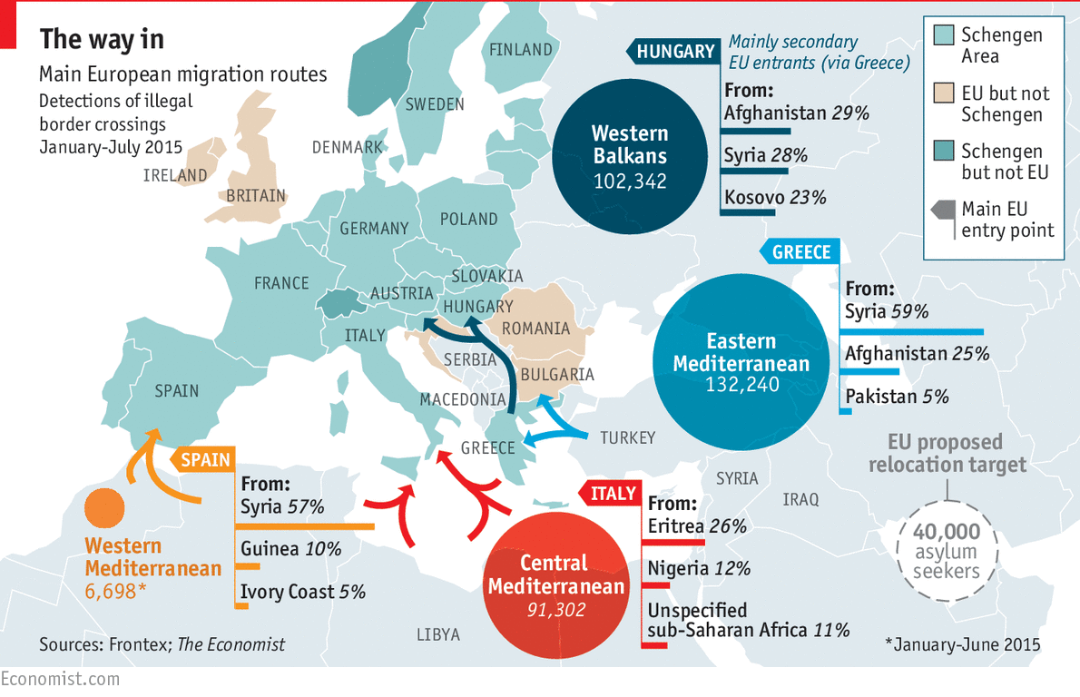
Geopolitical Instability
Conflicts, natural disasters and a lack of economic opportunity are also driving large movements of people around the world…

Slide 9
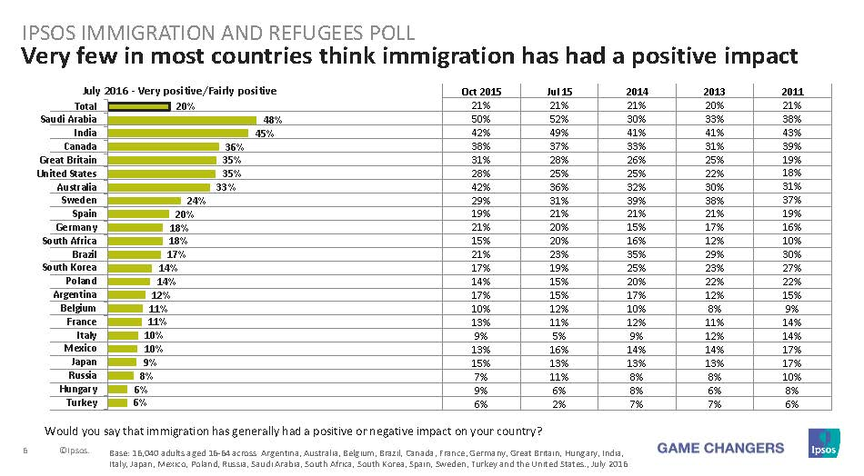
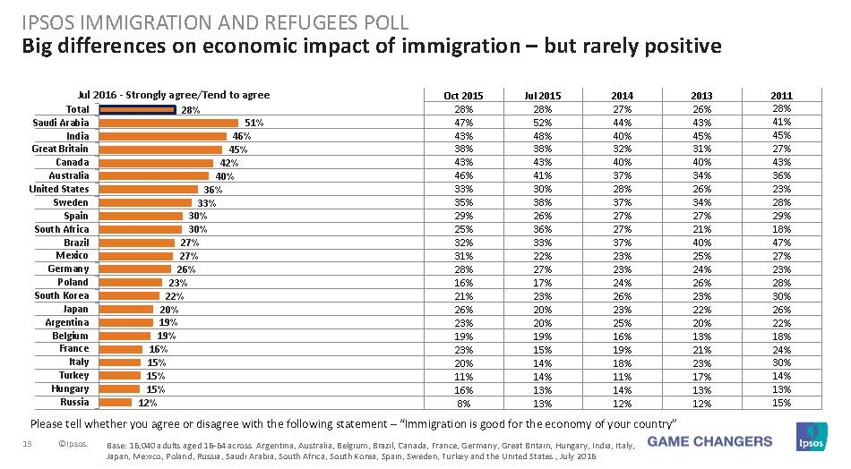
Global Immigration Faces Public Opinion
In many countries, public opinion of immigration is generally negative…

Slide 10
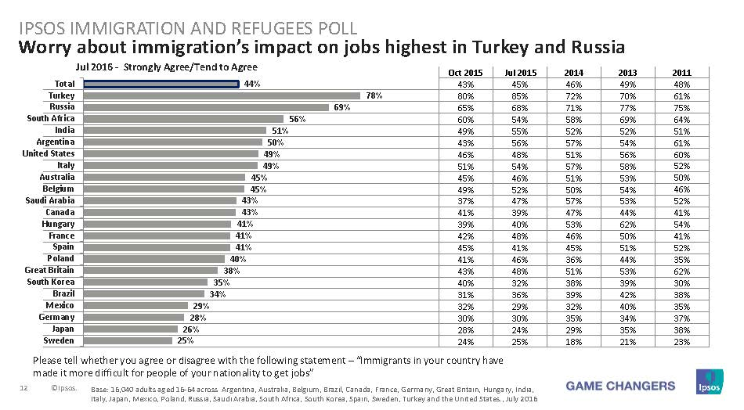
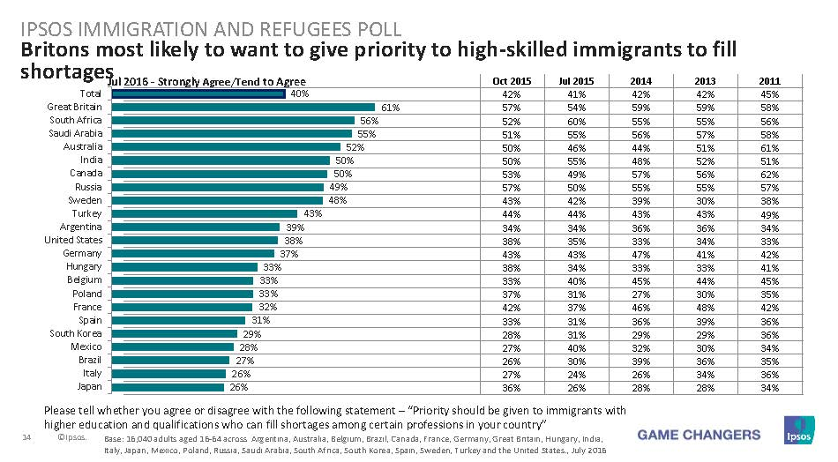
Public Opinion on Business Immigration
Opinion of the employment aspects of immigration is nuanced, but still problematic…

Slide 11
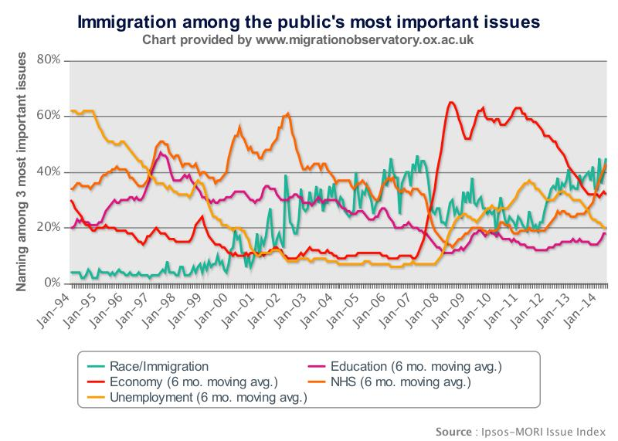
Public Opinion in the UK
The UK demonstrates the power of public opinion to shift policy….

Slide 12
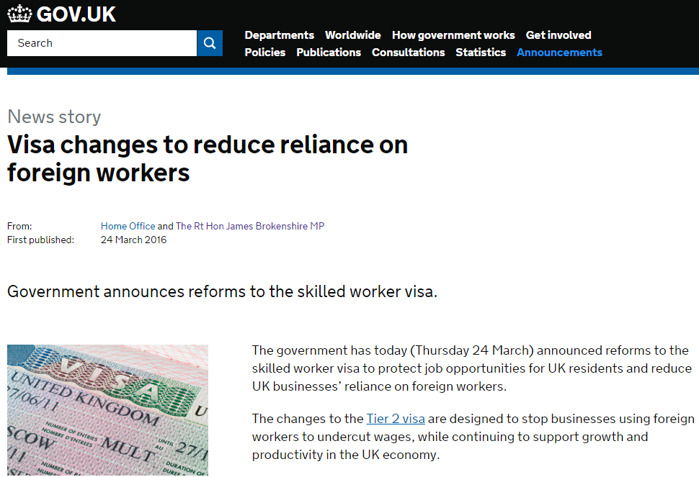
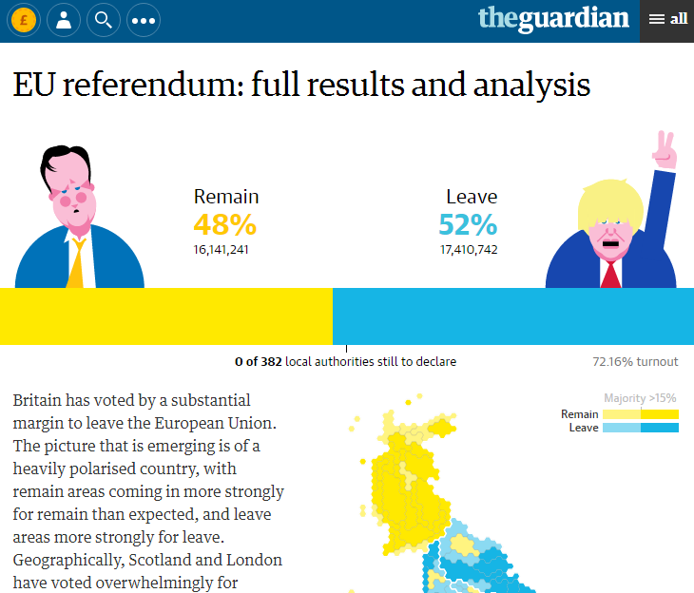
Politics of Immigration in the UK
Negative public opinion led to policies to curb immigration…

Slide 13
A Bleak Global Picture?
Globally, there is a policy trend toward restricting immigration, but it’s not universal…

Slide 14
What Does this Mean for Employers?
Restrictive immigration laws
Less certainty that you will be able to hire and deploy talent
Scrutiny of applications for work permits/visas
Adjudication processes take longer and are less predictable
Emphasis on enforcement
More resources required for monitoring and ensuring compliance
The negative political discourse around immigration has potential to impact the way you work…

Slide 15
Global Parallels in the United States
Skills Gaps
Per SHRM, 68% HR professionals are experiencing recruiting difficulty
Asked why, 50% said candidates lack work experience, 38% said they lack technical skills
Globalization
USCIS received 236,000 H-1B petitions against the 2017 cap of 85,000
Department of State issued 164,000 L visas in 2015
Immigration Politics
70% of registered voters say immigration is very important to their vote in 2016 (Pew Research Center)
HR leaders identified immigration reform as the 3rd most important election issue for HR in 2016 (Human Resources Executive)

Slide 16
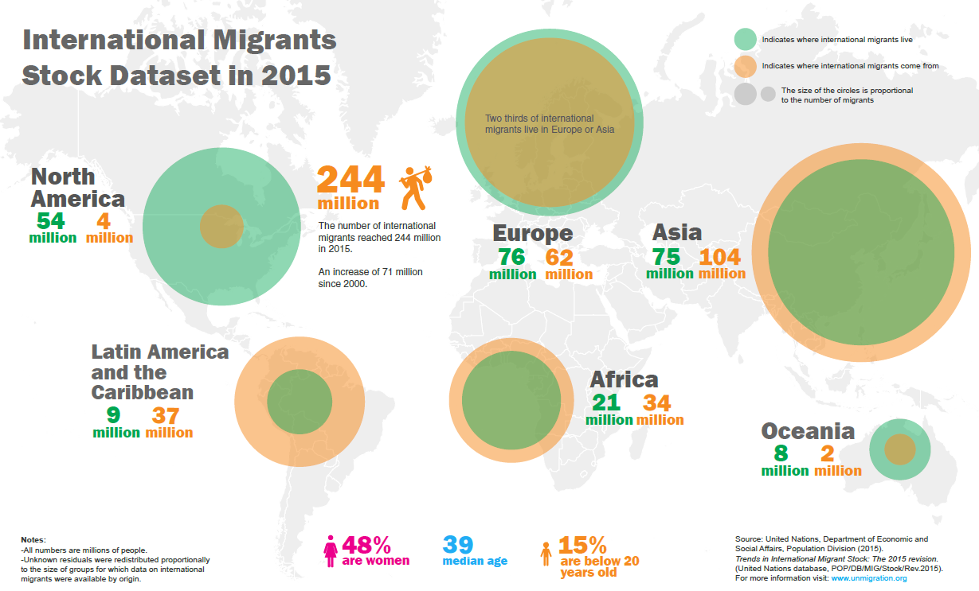
Migration Increased
Notes:
Securing global talent is difficult, and current political climate is going to make it harder, but there is still hope.
According to UN Migration is up 41% worldwide.

Slide 17
Immigration Paradigm
Migration
Policy Scrutiny
Regulations
Notes:
immigrants increased share of the world to 3.3% in 2015 from 2.8% in 2000

Slide 18
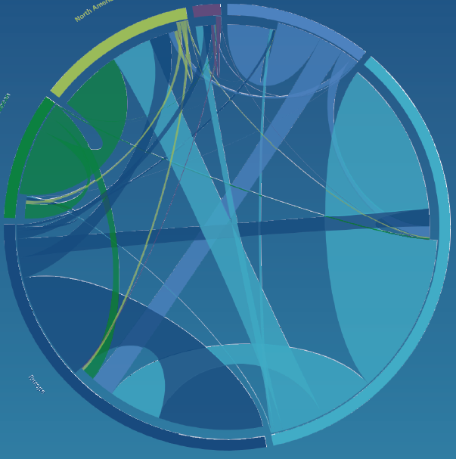
Opportunities: Be Prepared
International migrants by major area of destination and origin, 2015
Complex immigration increases opportunities for a prepared global HR to recruit talent.
A prepared global HR should understand immigration on a global scale
Asia
Europe
Latin America
Africa
North America
Oceania
Source:
United Nations, 2016

Slide 19
Immigration Overview
Around the world, immigration law is about . . .
Who can enter
For how long
For what purpose
Under what conditions
But if you know something about U.S. immigration, you can use that knowledge to manage global assignments.
Notes:
Since you are global HR here are some strategic considerations to make your global talent transfers work better

Slide 20
Objectives
Identify common themes and principles in immigration laws in the U.S. and globally to help you issue-spot.
Draw parallels between U.S. immigration and immigration to other countries to help identify common sets of requirements and pacing events.
Develop a standard HR immigration task list applicable for managing immigration for any assignment around the world.

Slide 21
Common Themes & Concepts
Work assignment requires authorization.
The greater the candidate’s education and salary, the easier the work permit and visa process.
Employees of related entities abroad generally may transfer more easily.

Slide 22
Common Themes & Concepts
Local and national labor protections play a key role.
The longer the intended stay, the more difficult & time-consuming the process.
Geopolitical and cultural similarity often play a role.

Slide 23
Requirements & Limitations
Common Set of Basic Corporate Requirements
Corporate registration and bona fides
Job offer or assignment letter
Wage obligations
Document retention

Slide 24
Requirements & Limitations
Common Set of Basic Individual Requirements
Nationality
Personal documents (often original)
Education
Work experience
Intra-company experience
Other special skills

Slide 25
Requirements & Limitations
Common Set of Basic Limitations
Admission limits & quotas
Local hiring/training requirements and ratios
Time limits
Purpose/activity limits
Family limits
Geographic/location limits
Social programs/benefits

Slide 26
Comparable Processes
United States | World
Labor Condition Application (for H-1B, H-1B1, E-3) | Labor Market Opinion/Test/Attestation
Nonimmigrant petition with U.S. CIS – H-1B, H-1B1, L-1, O-1, TN, E-3, E-1/2 | Work permit application with local, regional or national immigration authority
Consular visa application | Consular visa application
Admission | Admission
Form AR-11 Change of Address requirement | Address and/or in-person registration
Permanent residency (optional) | Permanent residency (uncommon)

Slide 27
Time Frames
Time frames vary over time, from place to place, and based on process.
Usually not as long as in the U.S., but build extra time for the unexpected.
Contact immigration counsel as soon as you know of the potential assignment.
Preliminary, time-saving steps you can take even before a formal offer and acceptance.
Know the pacing events.
Examples: Document legalizations, background checks, medical exams.

Slide 28
Pacing Events
Assignment awareness.
Initial document and information collection.
Prefilling requirements (medical exam, police clearance, background check, original/authenticated document collection, labor test).
Document execution and filing.
Post approval steps.
Admission into country.
Post arrival steps.

Slide 29
HR Information & Document Checklist
Corporate formation and/or relationship documents.
Evidence that the company is doing business in the target jurisdiction.
Signing authority & local point of contact in target jurisdiction.
Job description, salary, assignment letter.
Target start date.

Slide 30
Key Contacts Checklist
External Contacts
Immigration counsel
International taxation specialist
Relocation agency
Employment/labor counsel in target jurisdiction
Internal Contacts/Customers
Signing authority
Local contact
Local manager
Current manager

Slide 31
Expiration Tracking
Numerous immigration related documents may need to be monitored.
Visa
Admission Record
Work Permit
Residence Permit
Police Clearance/Registration
What systems do you have in place to track expirations?
What proactive steps need to be taken to ensure no gaps in employment or residence authorization?

Slide 32
The Global Status Quo
Whether in the U.S. or another country, immigration processes will require…
Staff to manage processes and ensure compliance
Time for government adjudications
Money for filing and legal fees

Slide 33
Opportunities for Business Advocacy
You can advance employer-friendly immigration policies at the global- and national- level...
Global Advocacy
National Advocacy

Slide 34
4 Advocacy Tips
Identify and leverage your government affairs network
Know your audience and what matters to them
Tell your story with data and anecdotes
Cite good and bad practices from other countries

Slide 35
Question and Answer
?

Slide 36
Contact Us
Kia Baptist – Kbaptist@dodi.com
Ryan Chargois – Rchargois@fosterglobal.com
Andrew Yewdell – Andrew.Yewdell@cfgi.org

