Slide 1
The 6 Practices of Strategic Global HR Leaders
Todd Averett

Slide 2
CEO Feedback- 2015 Deloitte Study
87% of senior leaders are deeply concerned about culture and engagement
86% are concerned about the leadership pipeline
80% are concerned about workforce capabilities
….clearly, they are worried about talent and culture!

Slide 3
CEO Feedback- 2015 Deloitte Study
CEO’s rating of HR’s organization performance as:
“Excellent” “Underperforming”
2015 5% 10%
2014 5% 10%
2013 3% 14%

Slide 4
CEO Feedback- 2015 Deloitte Study
80% of senior leaders report that their company’s HR skills- or lack of skills—are a significant issue.

Slide 5
How would your CEO rate
your Global HR efforts?

Slide 6
“Strategic Global HR”

Slide 7
The 6 Practices of Strategic Global HR Leaders
Thinking like a strategic HR Leader
Becoming a student of the business
Becoming a student of the people side of your business
Developing and proactively communicating people insights
Aligning people strategies to business strategies
Modeling the role of a trusted business partner

Slide 8
Thinking Like a Strategic Global HR Leader

Slide 9
What is my role?

Slide 10
Our Thinking
Our Behavior
Our Results

Slide 11
Global and Local Thinking

Slide 12
Global Thinking
Culture and Engagement
Leadership pipeline
Workforce capabilities

Slide 13
Global Thinking
Sensitivity to global events that impact the business
Awareness of international labor laws and wage rates
Awareness of recruiting and development challenges and approaches
Cultural sensitivity
Differences in approaches to compensation practices, performance management approaches, coaching, etc.

Slide 14
Global Thinking
Seeing Connections

Slide 15
Global Thinking
Tactical (but important) Global Thinking
Meetings and conference calls that fit global time zones—even if in the US we have to stay late or come in early
Materials and tools that are available in languages besides English
Providing translation for executive speakers when traveling to or speaking to international groups

Slide 16
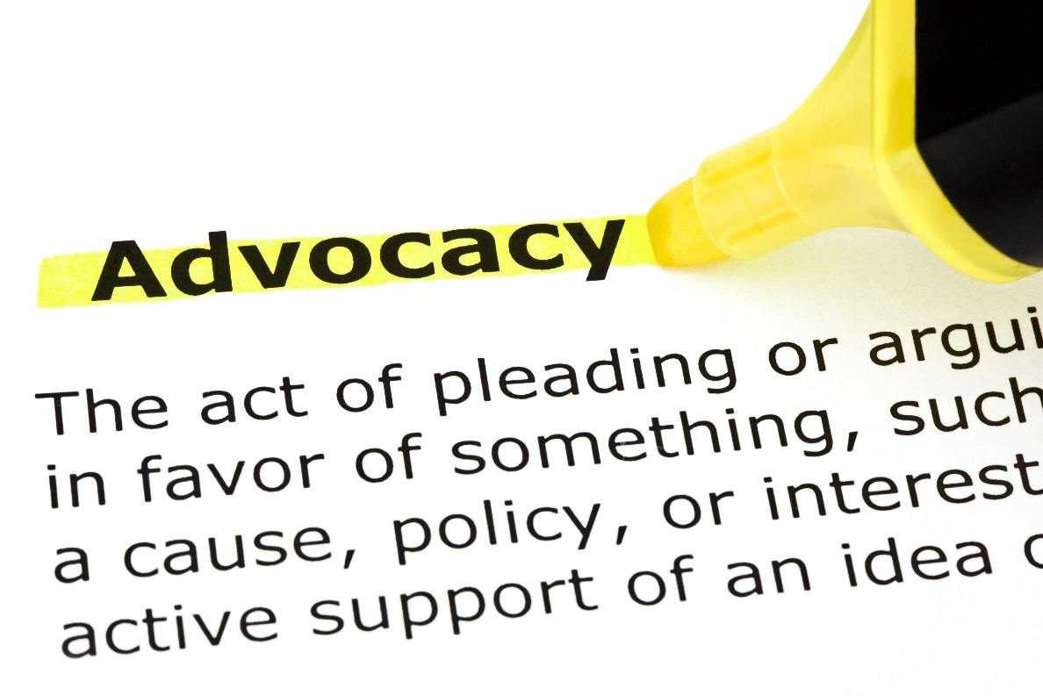
Global Thinking
Are you a strong, vocal advocate for the global and international people side of business?

Slide 17
Strategic Thinking
What new competitors, political changes, laws, regulations, industry trends, or new products or services are impacting us outside the United States?
How are we making sure that we as an organization are aware of these changes and proactively addressing sales opportunities and business risks?
How are HR efforts going to support these changes?

Slide 18
Design Thinking
Designing For:
Feasibility (what is functionally possible within a foreseeable future)
Viability (what is likely to become part of a sustainable business model)
Desirability (what makes sense to people and for people)

Slide 19
Design Thinking Principles
Human-centered Design
Visual Thinking
Divergent and Convergent Thinking
Rapid testing and prototyping
Mapping the Journey
Telling the Story

Slide 20
Design Thinking
Example: Human- Centered Design
Insight
Observation
Empathy
Asking for feedback from employees
Looking at data
Watching what employees do and don’t do while going through HR processes
Considering the views of different demographics; look at the “edges” for insight
Mapping the emotions that employees feel as they go through HR processes

Slide 21
Design Thinking Principles
Are we designing a local solution or a global solution?

Slide 22
Design Thinking Opportunities
Compensation structure
Performance Management System
HRIS Systems
Training and Development
Promotion/career development guidelines

Slide 23
Becoming a Student of the Business

Slide 24
Knowing the Business
How well do you know the business operations outside of the US?
Do you know what key changes occurring globally can have the biggest impact on your business?
Do you know what support your global operations teams need from HR—and the company overall?

Slide 26
Learning the Business
Ask lots of questions about global operations-about business results, business strategies, operating disciplines, competitors, and customers.
Take notes when key business leaders speak about global operations.
TRAVEL TO OTHER COUNTRIES
TAKE AN INTERNATIONAL ASSIGNMENT
Read as much as you can related to:
Your global business results (investor’s presentations, stock filings, etc.)
The global marketplace for your products and services
Investors’ analysis
Countries you operate in

Slide 27
Becoming of the Student of the People Side of Business

Slide 28
Building and Leveraging Your Human Resources
“Home Room”
Recruiting
Employee Relations
Learning and Development
Organization Development
Compensation and Benefits
Notes:
Todd. 3 minutes.

Slide 29
”High Impact HR Organizations”, Bersin 2011
Solid execution of fundamental HR services is essential to demonstrating competence and building credibility with leaders outside the function.
Organizations that rated themselves as “below average” at core services, such as recruiting, onboarding and basic skills development, were three times more likely to complain of a lack of respect from business leaders.

Slide 30
Global HR
Are teams responsible for Global HR delivering on “the basics?”
Do you have an understanding of international labor laws?
Do you have an understanding of international compensation approaches?
Do you have an understanding of international expectations for hiring, performance management, career development, and training?

Slide 31
Strategic Talent Management Practices
Organization Design
Leadership Development
Workforce forecasting and planning
Building Employee Engagement
Leading Change
Strategic Performance Management

Slide 32
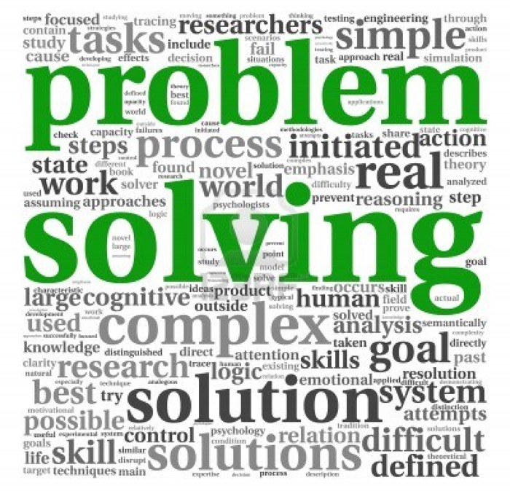
Consultative and Problem Solving Skills
Finding root causes
Needs analysis
HR theory AND application
Using models and frameworks
Developing and testing a hypothesis

Slide 33
Sample Experience Map
 | HR Specialty Area | Organization Design | Workforce Forecasting | Leading Change | Employee Engagement | Problem Solving and Consultative Skills
Current Experience Level
Desired Experience level
How I Will Build Experience

Slide 34
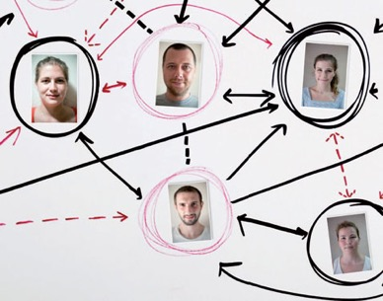
Developmental Approaches
Continuing Education
Mentors
Rotational Role
Research
Cross-functional project team

Slide 35
Developing and proactively communicating talent insights

Slide 36
Greatest HR Challenges Faced by Today’s HR Leaders (Bersin, 2011)
Measuring HR programs in Financial Terms
Delivering workforce metrics and analytics
(out of 14 items…”Selection and Recruiting of Talent was #14)

Slide 37
+
Information
+
INFORMATION
The Story
THE STORY
Quantitative Data
# of openings, how long open, source of hire
Time to competency
Quality of new hires
# of calls/call center associate
$ Sales/associate
Turnover rate
Average tenure
Performance evaluation ratings
Test scores
Quality metrics
Payroll/benefits costs
Worker’s compensation reports
Exit survey data
Satisfaction survey data
Talent review data
Qualitative Data
Observations
Interviews
Patterns, trends
Stories/experiences of customers or employees
Sample comments
Focus Group data
*The best stories are:
Simple
Unexpected
Concrete
Credible
Emotional
*From “Made to Stick”, Chip and Dan Heath, 2007
Notes:
Todd. Brief review. 3 minutes

Slide 38
Global Insights
Salary market rate/annual increase trends by country
Retention rates by country and most important engagement factors by country
Severance process and severance costs by country
Time/costs/process required for work permits for expats
Expat compensation and benefit trends, costs, changes

Slide 39
Self Rating
How often are your Global HR priorities and programs driven by data and analysis?
How often is the data you share actually helpful in terms of understanding an issue
or predicting what might happen in the future?
How often do you come to meetings with people or performance data and insights without being asked first?

Slide 40
Developmental Approaches
Continuing Education
Mentors
Rotational Role
Research
Cross-functional project team

Slide 41
Aligning people strategies with business strategies

Slide 42
“CEOs want HR to be orchestrators of the business strategy, not simply executing HR processes without any thought for the context. Like leaders in most fields they expect HR to be contextually grounded.”
“It is a challenge to align HR ambitions with what we can afford and keep focused on the strategic rather than on the next new thing in HR.”
-What CEOs Want From HR
University of Reading, UK

Slide 43
Prerequisites
You will need to think strategically. (Practice #1)
You will need to be a student of your business. (Practice #2)
You will need to be a student of the people side of your business. (Practice #3)
You will need to be able to develop and communicate people insights. (Practice #4)

Slide 44
4 Alignment Phases
Identify key gaps to accomplishing business strategy
Determine which people strategies can have the biggest positive impact on the overall business strategy
Execute and evaluate progress- and say “no” to non critical activities
Build a plan with prioritized activities, timelines, and plans
Notes:
Brian. 2 minutes

Slide 45
Global Application Questions
What is a key GLOBAL strategic initiative that your business is focusing on right now?
What are the biggest challenges to accomplishing that strategy within your business?
What GLOBAL people or talent approaches could have the most positive impact on addressing those challenges?

Slide 46
Evaluating Global HR Activities
Must this activity really be done at all?
Legally required
Is this “how we have always done it?”
What will happen if this is not done, really?
Can this activity be done with a different frequency?
Can this activity be simplified?
Must this activity be done by HR?
Outsource
Done by employees (self service) or by managers (manager self service)
What are the most COURAGEOUS choices you can make?

Slide 47
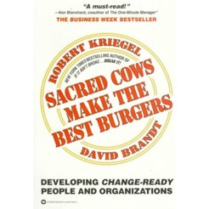
Sacred cows make the best burgers.
-Robert Kriegel and David Brandt.

Slide 48
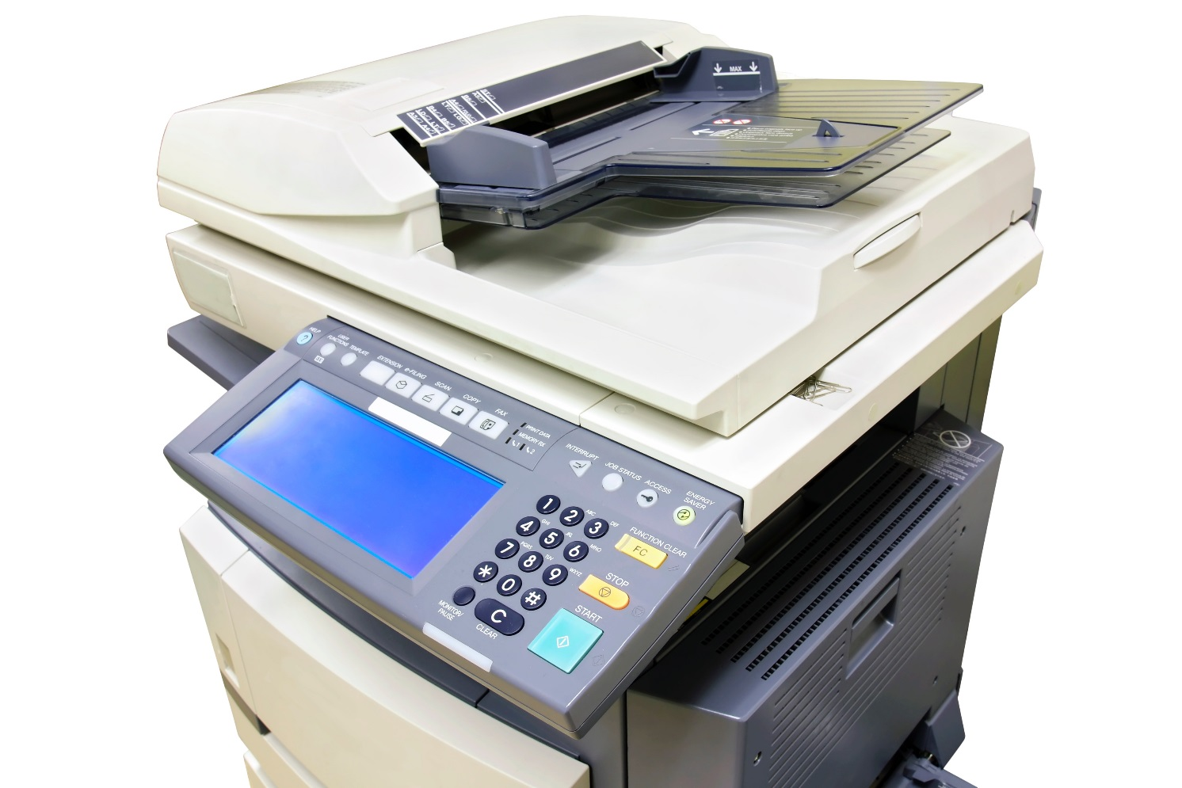
A Caution about “HR and Administration” Departments

Slide 49
Modeling the role of a trusted business partner

Slide 50
Are you a TRUSTED business partner?

Slide 51
Your Trust Account Balances
With your boss?
With your direct reports?
With your peers?
With international employees overall?
With members of the international/global management team?

Slide 52
Building Your Trust Account
Visibility
Courage
Confidentiality
Collaboration
Credibility
Notes:
Todd. Verbal content. 5 minutes

Slide 53
Building trust may look differently in different cultures

Slide 54
If you need to work on trust, remember that:
It will take time…perceptions about credibility, courage, confidentiality, and collaboration are formed quickly but take a long time to change
Be very deliberate in what you do, to ensure that your behavior demonstrates the model that you intend
Articulate to others what you are working on and ask for feedback; be a model of a

Slide 55
The 6 Practices of Strategic Global HR Leaders
Thinking like a strategic HR Leader
Becoming a student of the business
Becoming a student of the people side of your business
Developing and proactively communicating people insights
Aligning people strategies to business strategies
Modeling the role of a trusted business partner

Slide 56
Accountability
You have a choice.
Victim

Slide 57
What Will You Do Next?

Slide 58
Tools You Can Use
Please contact me if you’d like these free tools:
Experience Map
6 Practices of Strategic HR Leaders Assessment (beta version)
45 minute phone strategy session on implementing the 6 Practices at your organization
todd@leadingpeoplepartners.com

