Slide 1

Managing the Complexity of Global HR

Slide 2

speaker
MICHAEL BUTLER
Head of HR Services
Tel: 617.353.8393
Michael.Butler@radiusww.com
Mike Butler has more than 20 years experience working in the UK, France and US as a European HR executive and consultant working with such companies as United Airlines and Jones Lang Lasalle. Mike currently advises US companies setting up remote Sales / IT teams outside the US on all aspects of international expansion. Mike has both the CIPD (UK) and GPHR (US) HR qualifications as well an MBA. He currently sits on SHRM’s global expertise panel.

Slide 3
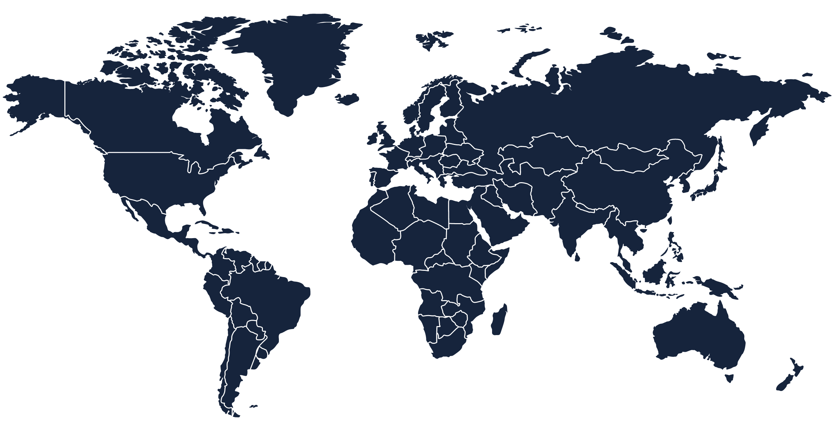

WHAT WE DO
RADIUS HELPS COMPANIES EXPAND AND WIN GLOBALLY. CLIENTS FROM STARTUPS TO LARGER MULTINATIONALS TAKE ADVANTAGE OF RADIUS’ INTERNATIONAL ACCOUNTING, FINANCE, BANKING, TAX, HR, LEGAL AND COMPLIANCE SUPPORT TO SIMPLIFY THEIR CORE OPERATIONS, REDUCE THEIR RISK EXPOSURE AND IMPROVE THE MANAGEMENT AND CONTROL OF THEIR OVERSEAS BUSINESSES.
VISIT OUR WEBSITE AT WWW.RADIUSWORLDWIDE.COM OR CALL US AT +1 888.881.6576.

Slide 4

Business considerations for the payroll & HR teams
Company Structure
& Tax
Overseas Payroll / HR Frameworks
Budgeting for Payroll / HR Costs
Winning Globally

Slide 5
Business considerations for the payroll & HR teams
Company Structure
& Tax
Overseas Payroll / HR Frameworks
Budgeting for Payroll / HR Costs
Winning Globally

Slide 6


Winning globally
WITH STRONG DOMESTIC MARKETS, IT’S BEEN EASY FOR BUSINESSES IN THE US AND WESTERN EUROPE TO FOCUS ON THEIR HOME MARKETS

Slide 7
Winning globally
CALL IT THE RIP VAN WINKEL SYNDROME, BUT WHILE BUSINESSES IN THE WEST HAVE BEEN MORE PROVINCIAL THAN NECESSARY, THE WORLD HAS CHANGED—IN MANY SURPRISING WAYS…

Slide 8
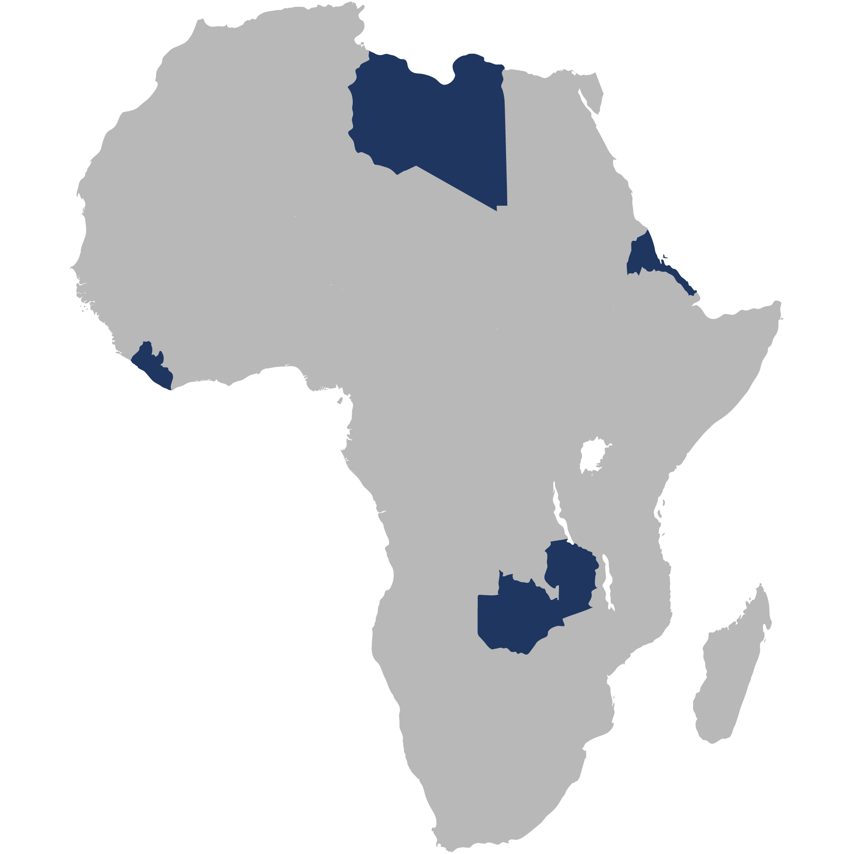
Winning globally
#4 Libya
According to the Economist, four of the fastest growing economies in 2014 will be in Africa
#9 Eritrea
#2 Sierra Leone
#10 Zambia

Slide 9
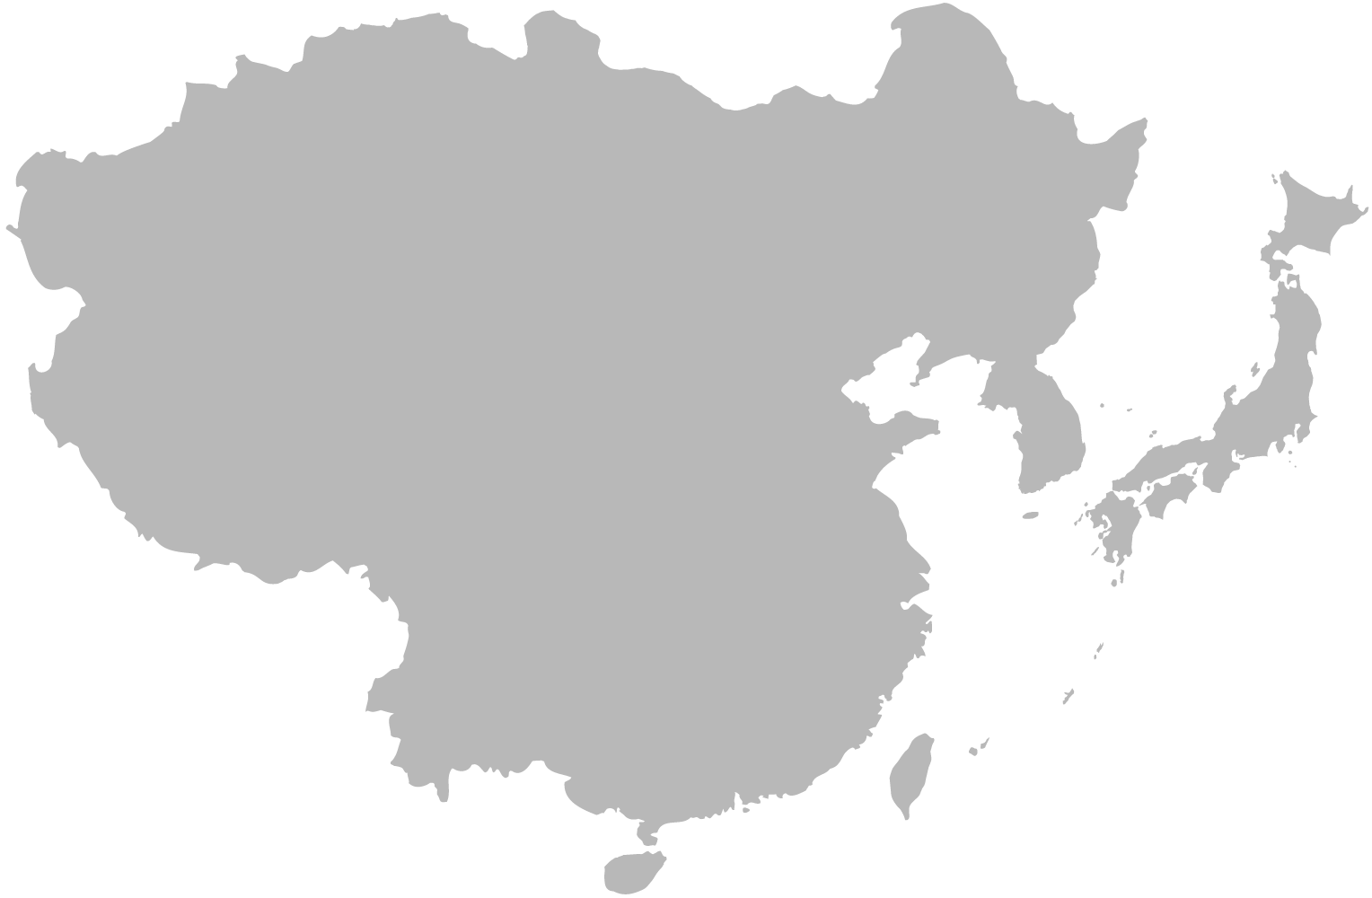
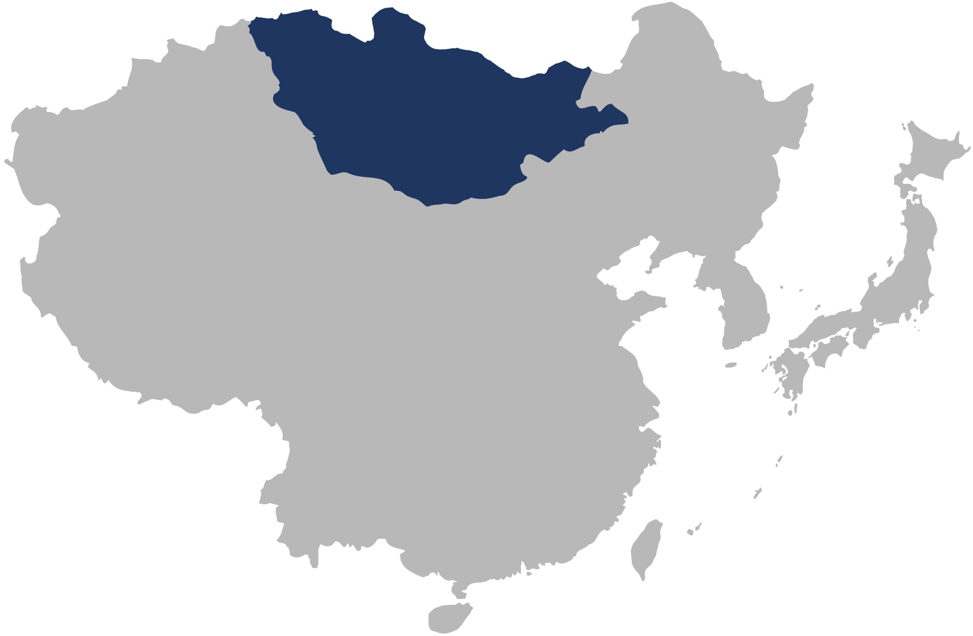
Winning globally
The world’s fastest growing economy?
Not China, but Mongolia at +15.3%.

Slide 10


Winning globally
China is to surpass the US in luxury car sales by 2015.
CHINA
US

Slide 11



STAY LOCAL OR GO GLOBAL
1
2
3
4
You have strong, consistent demand domestically for your goods or services.
Domestic demand
is robust, but international demand may be growing even faster.
Domestic business is slow or stagnant.
You may have a product advantage in other countries.
BE CAREFUL WITH THIS ONE!

Slide 12




STAY LOCAL OR GO GLOBAL
5
6
7
8
Competitors are moving into other markets.
You already have international customers.
You have global clients you need to service face-to-face.
You have a window of opportunity that could close soon.

Slide 13

GLOBAL EXPANSION OPPORTUNITIES
Identifying Indicators
WHERE TO GO FIRST?
You’ve given careful consideration to the issue of international expansion, and many indicators tell you the time is right to
make your move.
The big question you now face is, where?
#GlobalSWP

Slide 14

Each country has its own unique set of considerations, making the choice of where to go first far from obvious. There is no universal formula for selecting a country for overseas expansion. You’ll have to evaluate the field based on the unique position and needs of your specific enterprise.
#GlobalSWP

Slide 15



CONSIDER THESE FACTORS
1
2
3
4
Regional Beachheads – Choosing a gateway country to a target region.
Large, Growing Markets – Looking at national market potential for your product or service.
Ease of Doing Business – Factoring in difficulty of setting up and operating.
Large, Wealthy Markets – When the market needs to support luxury goods.
#GlobalSWP

Slide 16

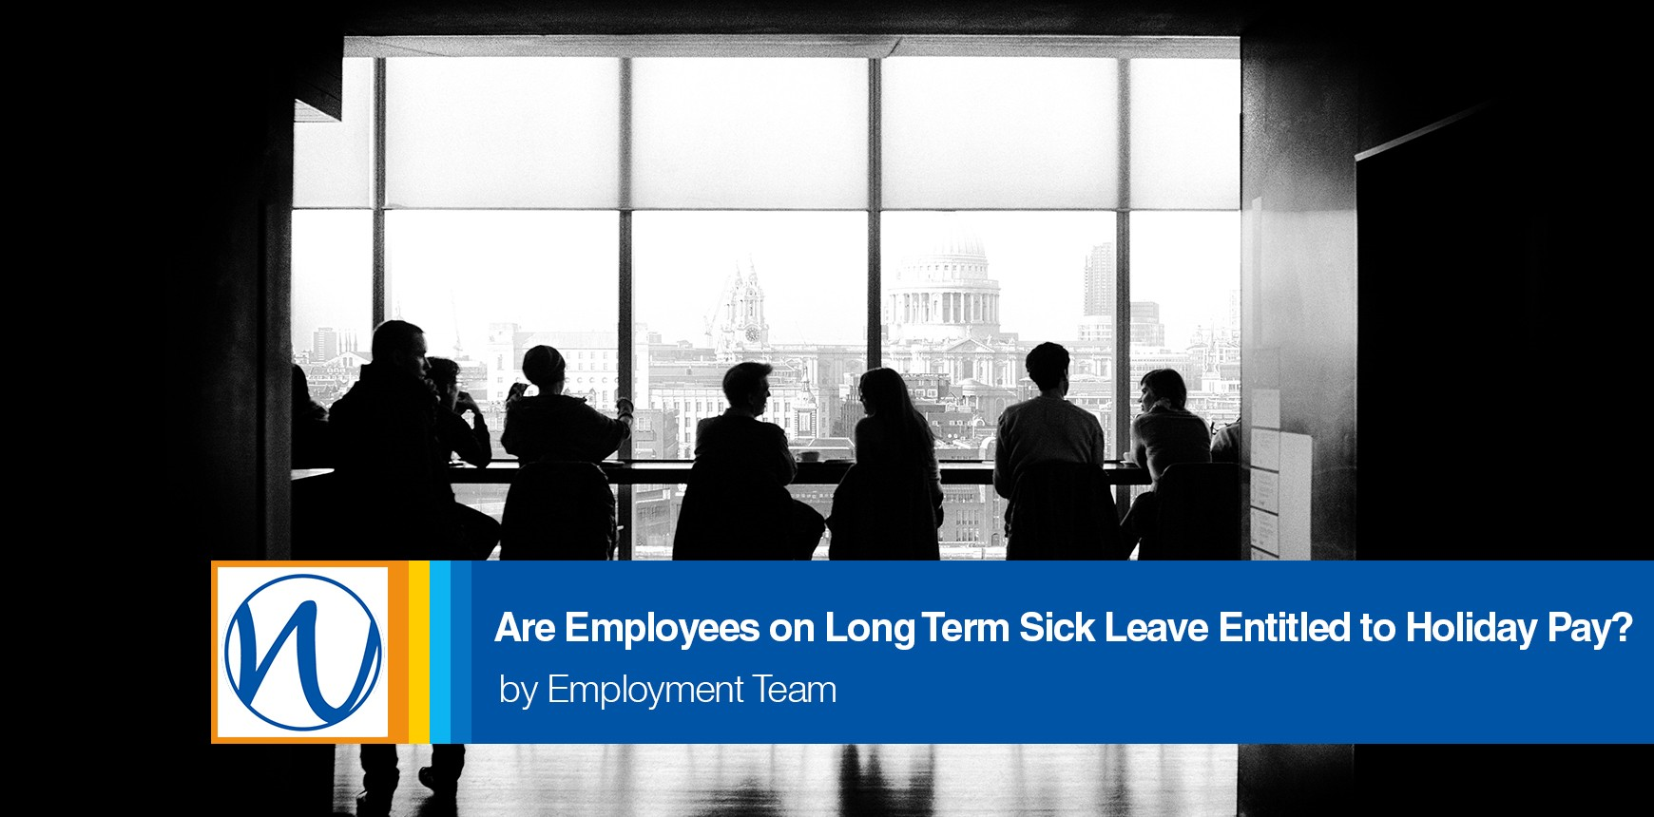
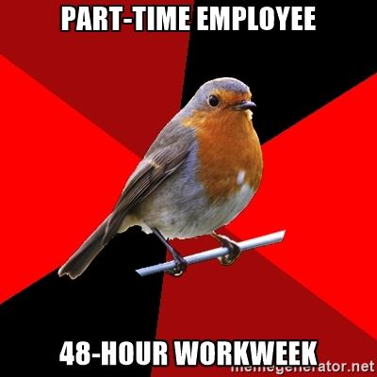



Significance for employment rights?
Holiday pay when on sick leave
Holiday pay includes commission
Reschedule holiday if break arm

Slide 17




CONSIDER THESE FACTORS
5
6
7
8
Technology Acceptance & Innovation –
Weighing the importance of early adoption and infrastructure.
Vertical Potential – Unique factors to consider for your industry in the countries you are considering.
Sourcing –Availability of resources, labor costs, proximity to sales markets, skills, and business environment.
Tax – The structure and location of your overseas operations will have tax implications.
#GlobalSWP

Slide 18




Introduction
What are the top two countries for innovation?
It’s not the US (#3) or Japan (#4)
but South Korea (#1) and Sweden (#2).

Slide 19



Introduction
Who is the most entrepreneurial?
ICELAND
CYPRUS
NEW ZEALAND
  Where does the US rank in new businesses per 1,000 adults?
NUMBER
32

Slide 20
Winning globally
The Sunday Times of London’s “Rich List”
The only city with more?
48
43
72
There are more billionaires in Moscow than in New York.
London, with 72.

Slide 21

It is important to consider where it’s easier to attract and retain the types of employees the company will need

Slide 22

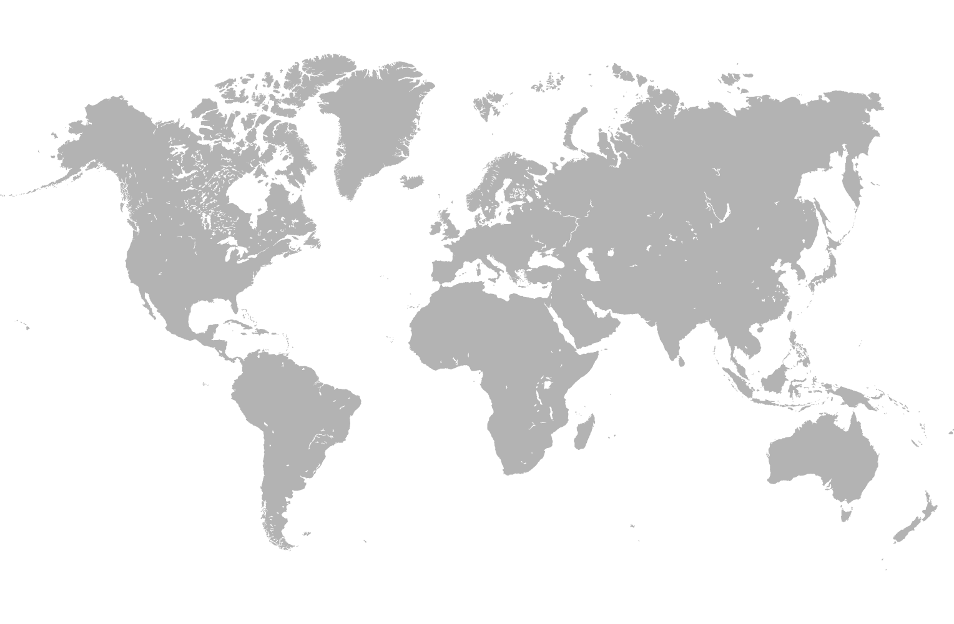

Winning globally
It’s easier to do business in Lithuania (#17) than in Germany (#21)

Slide 23


Winning globally
It’s easier to do business in Malaysia (#6) than in Japan (#27)

Slide 24


Winning globally
It’s easier to do business in Georgia(#8) than in the UK (#10)

Slide 25


Winning globally
The world’s most business-friendly?
It’s not the US (#4) but
Singapore (#1)

Slide 26
Business considerations for the payroll & HR teams
Company Structure
& Tax
Overseas Payroll / HR Frameworks
Budgeting for Payroll / HR Costs
Winning Globally

Slide 27
A COMMON SCENARIO (Today’s Agenda)
Situation
  VP of Sales walks into the Director of HR’s office with two signed offer letters to hire new sales people in France (or Brazil…or Zimbabwe)
  The company doesn’t HAVE an office in France (or Brazil…or Zimbabwe)
Considerations
Do we need an entity in country? If so, what are our options?
How employee activities can create a taxable presence?
How to manage overseas talent?
When budgeting what are the hidden staffing costs?

Slide 28



ENTITY TYPES
Representative Office
Branch Office
Subsidiary
One of the easiest ways to get setup overseas
Allows a company to establish a minimal presence
Employees cannot engage in sales or contractual matters
“Market development”
An extension of a parent company, serving a certain geographic area
Can engage in core activities, sales, etc.
Not a separate legal entity; foreign parent subject to all liability
Potential for taxation of overseas profits in UK
A separate legal entity for engaging in business overseas
Provides a layer of protection between the interests of the parent and the on-the-ground entity
Long setup and registration time; heavy oversight

Slide 29

Company Structure from a HR Perspective
Employment Brand
Permanent Establishment
Company Structure
Speed of Hire
Employee Benefits

Slide 30





ALL THE PRESIDENT’S MEN
Carl Burnstein
Bob Woodward
Deep Throat

Slide 31





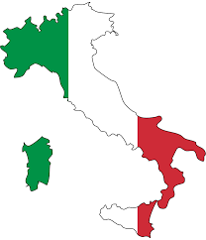
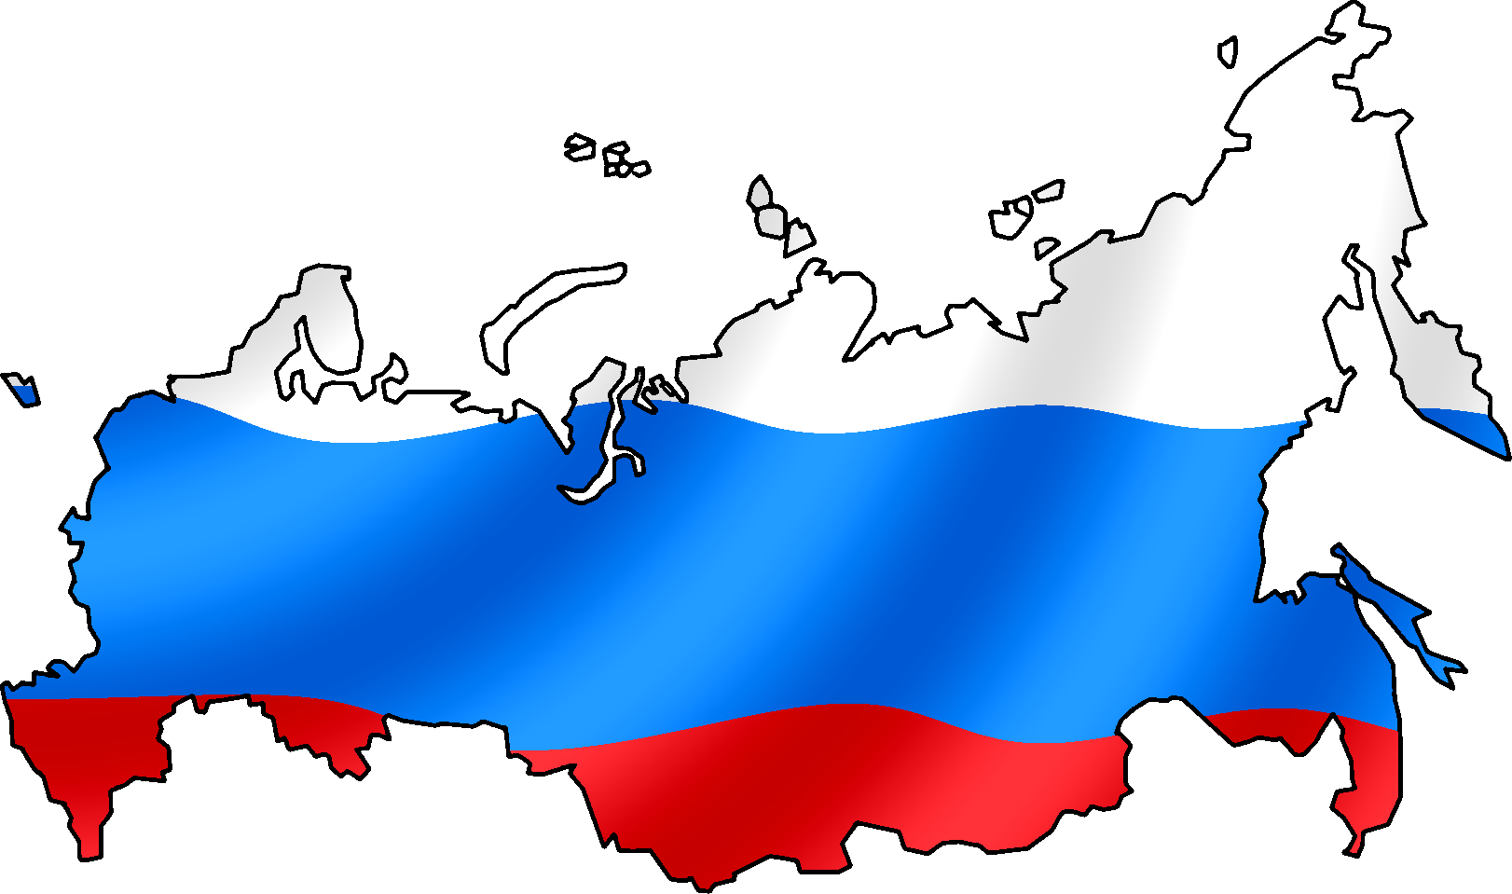
Follow the Tax Money

Slide 32

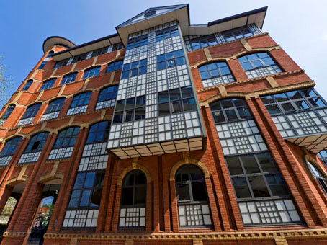



HR and PERMANENT ESTABLISHMENT RISK
Types of Roles
Fixed Place of Business
Permanent
Establishment
Employment Documentation
Sales Commission

Slide 33
Business considerations for the payroll & HR teams
Company Structure
& Tax
Overseas Payroll / HR Frameworks
Budgeting for Payroll / HR Costs
Winning Globally

Slide 34

Value the diversity Across the Pond
We have lots
in common . . .

Slide 35



Royalty

Slide 36


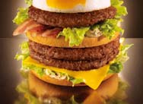

Haute Cuisine

Slide 37
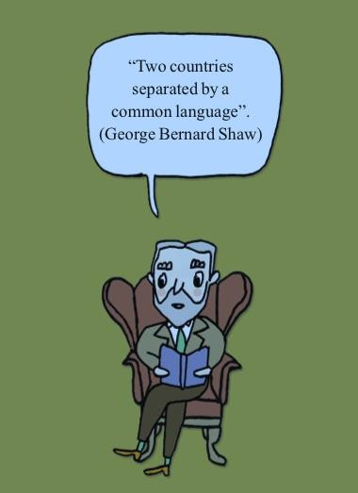
But there are differences …
Language – a US drafted contract does not always translate in the UK
Legal systems: both common law systems but very different, including employment law

Slide 38
Global Staffing Plan
International Staffing
Profile
Local Hire Employees
Documentation
Notes:
.

Slide 39
Sample u.s. offer letter
Dear Jane Doe,
On behalf of XYZ INC. (the “Company”), I am pleased to confirm our offer of employment to you for the position of EMEA Regional Sales Director …
You will be paid a base salary of $5,000 per month less applicable tax and other withholdings.
You will also be eligible to participate in various Company fringe benefit plans, including group insurance and 401(k) programs. You will also be eligible for fifteen (15) days of paid time off (PTO) each year.
Subject to the approval of the Company’s Board of Directors, you will be granted an option to purchase X shares of Company common stock….
Your employment with the Company is “at will.” It is for no specified term and may be terminated by you or the Company at any time, with or without cause or advance notice…

Slide 40
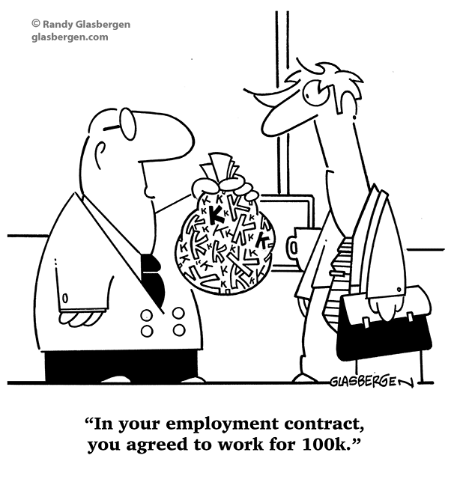
Local HIRE EMPLOYEE
Are Contracts Necessary And What Should They Look Like?

Slide 41

Global Staffing Plan
International Staffing
Profile
Local Hire Employees
Contractor
Contactor vs
Employee

Slide 42



What You Should Know About Engaging Contractors
“Test the
waters” in a
new market
Financial
Penalties
Employee
v
Contractor

Slide 43

Global Staffing Plan
International Staffing
Profile
Local Hire Employees
Expatriates
Contractor

Slide 44

TRANSFER EXPATS OR HIRE LOCALS?
If the target country has a limited local talent pool for the particular industry, expats may be an option. Fluency in the language used at HQ is another vital skill, which may or may not be easy to find locally.

Slide 45
However…

Slide 46




TRANSFER EXPATS OR HIRE LOCALS?
Salary
Language
Compliance
Commitment
The rule of thumb for the all-in cost of an expat assignment is generally between two to three times the expat’s home-country salary.
The most important reason to go with locals is that they speak the language, understand host-country business customs, and often come with strong local connections.
An EY study on global mobility¹ notes that 64% of companies surveyed incurred avoidable penalties for non-compliance when sending expats.
When you have locals running your office and selling your products and services, you’re sending a message that you’re part of the local business community, and that you’re here to stay.
¹Global Mobility Effectiveness Survey 2013

Slide 47
Business considerations for the payroll & HR teams
Company Structure
& Tax
Overseas Payroll / HR Frameworks
Budgeting for Payroll / HR Costs
Winning Globally

Slide 48

WHAT’S THE BOTTOM LINE?
WHEN CONSIDERING OVERSEAS EXPANSION, FIGURING OUT DIFFERENT EMPLOYMENT FRAMEWORKS & COSTS IS A TOP PRIORITY FOR HR

Slide 49



WHY GET COST ESTIMATES?
Reliable estimates justify international expansion
Allows you to compare investment and return in different countries
Enables you to set profit and loss (P&L) goals

Slide 50
RESEARCH CHECKLIST
Staff Expenses
Setup Expenses
Budgeting Checklist
Salaries
Social Security
Unemployment Insurance
Health Insurance
Incorporation Fees
Filings
Legal Services
Marketing Expenses
Tax Expenses
Office Expenses
New marketing Materials
Advertising, PR, Lead Gen
New Sales Materials
Website Translation
Corporate Taxes
VAT Taxes
Import Duties
Accounting/Audit
Office Rental / Taxes
Equipment
Health and Safety Inspections
Communication Services

Slide 51




COUNTING THE COST of HR
10%
Social Security
Mandatory Extras
Customary costs
Recruitment
Headcount related
Termination
Indirect Costs

Slide 52

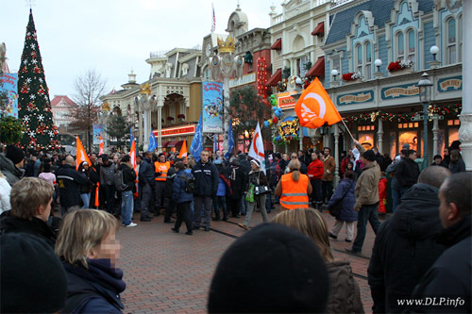
Recruitment in Disneyland Paris

Slide 53

Budgeting for talent - location
43 kms

Slide 54



Haute Cuisine to Flipping BURGERS
Getty Image
Disney Images

Slide 55




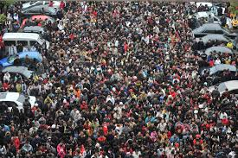

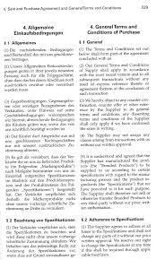
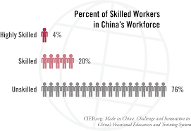

Hidden recruitment Costs
Translation Services & Languages
Wage Inflation
Unions & CBAs

Slide 56
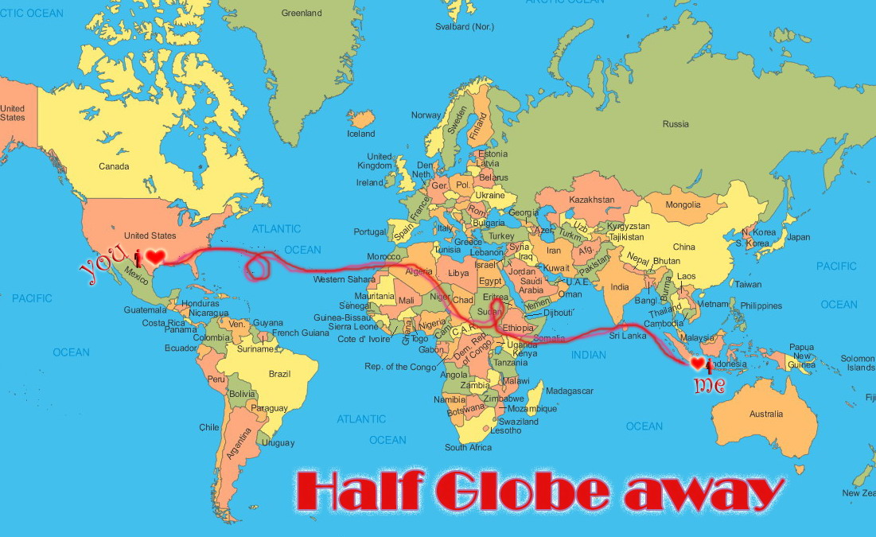



Hidden EXPAT Costs

Slide 57

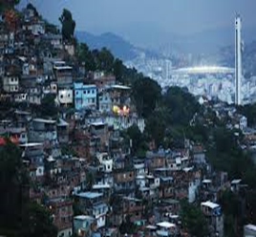

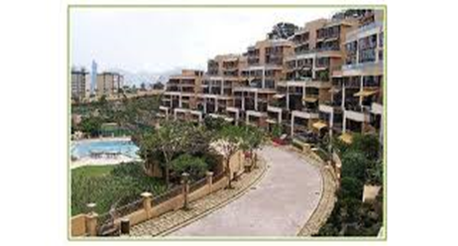
Expat housing & SECURITY

Slide 58




SOCIAL SECURITY – a real cost
Typical employer
contribution
10%
France employer
contribution
44%
$88,000
Employer cost

Slide 59








Budgeting for MANDATORY BENEFITS
10% Profit sharing
Workers Compensation
Life insurance
Study Fund

Slide 60


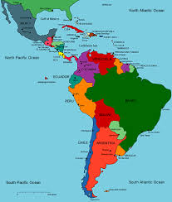

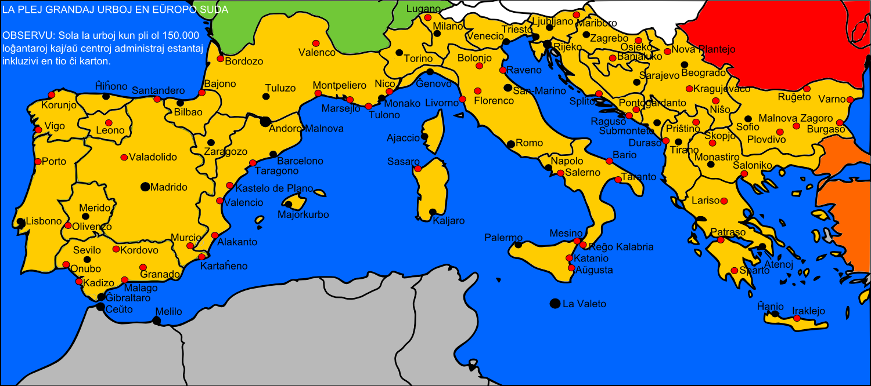

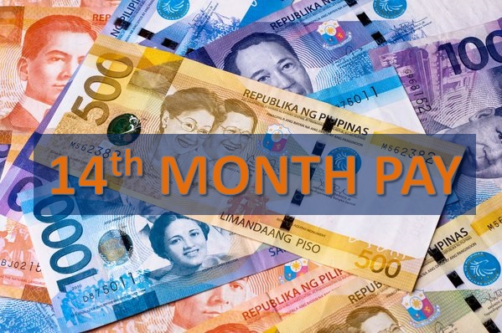
Budgeting for CUSTOMARY Benefits
Latin America
Commuting Allowance
Supplemental Health Insurance
Luncheon vouchers
Bonus months
Southern Europe

Slide 61


Costs associated with headcount
Individually
Underwritten
Insurance Polices
Market rate data from
large employers
Expensive
Premiums

Slide 62


‘Employment at will’

Slide 63
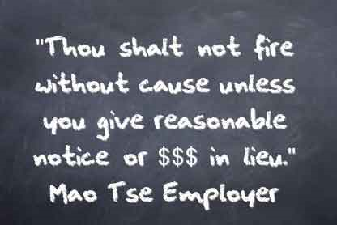
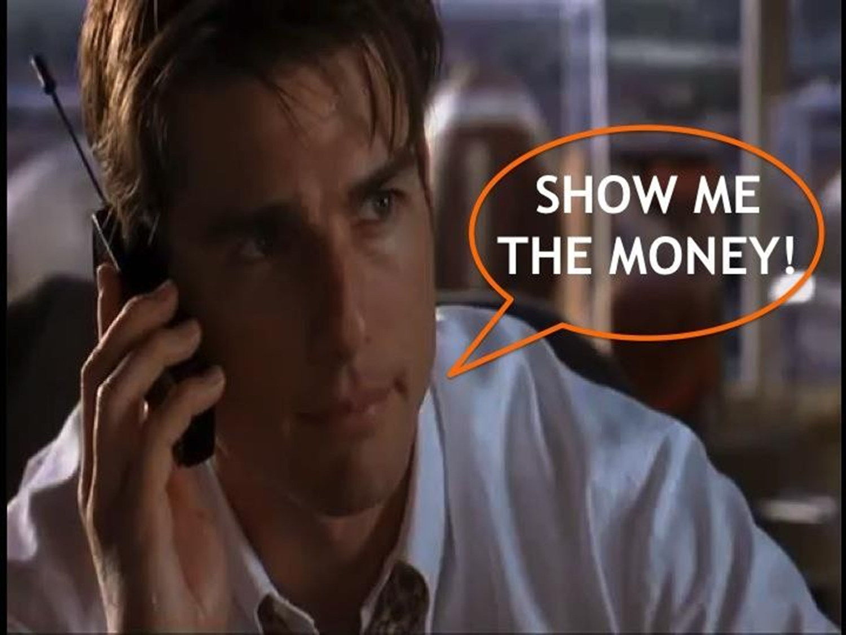





Termination Costs
Termination
2
Years

Slide 64

Indirect Costs of Employee absence
.
Paid time off /
Time of in lieu
Vacation Accrual
& carryover
Overtime Premiums

Slide 65



Annual leave carry over
Mexico
Sweden
18 months
after accrual
5 days per year
Max 25 days
India
Japan
3 times annual
allowance
Next leave year

Slide 66






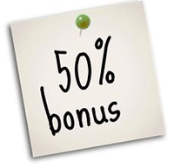

Vacation bonus

Slide 67


Work / life balance

Slide 68



UK: PERSONNEL
13.8% of salary goes towards social security, with no cap.
4% of salary is contributed to a mandatory
pension and is planned to rise.
$1,000 - $4,000
per employee is contributed towards employer’s liability.
Health & safety obligations are required if you employ five or
more in the UK.

Slide 69


FRANCE: PERSONNEL
40-45% of base salary is contributed to social security plus additional insurances such as medical.
These additional expenses may run up to $5000 per employee per year.
Mandatory 35-hour work week.
It is a requirement to monitor working time for all employees. Working overtime usually requires additional compensation.
Discretionary bonuses given to high performing employees may become contractual based on perceived precedent.

Slide 70
MEXICO: PERSONNEL
There is less pressure to provide expensive benefits in Mexico, due to weaker private sector unions.
You are expected to offer 10% of annual Mexico entity profit towards employee profit sharing.
Mexico has an excellent public health system

Slide 71
QUIZ ANSWERS

Slide 72
Hidden Cost 1
Which of these statements is NOT true.
In parts of Germany there is a “Church Tax” that employers MUST pay – which helps to fund the churches.
In Mexico there is a Halloween Bonus – of an extra days pay to everyone that works on that day.
In the Philippines EVERY employee is entitled to a 50Kg sack of rice per month (or the monetary equivalent).

Slide 73
Answer
In parts of Germany there is a “Church Tax” that employers MUST pay – which helps to fund the churches.
In Mexico there is a Halloween Bonus – of an extra days pay to everyone that works on that day.
In the Philippines EVERY employee is entitled to a 50Kg sack of rice per month (or the monetary equivalent).

Slide 74
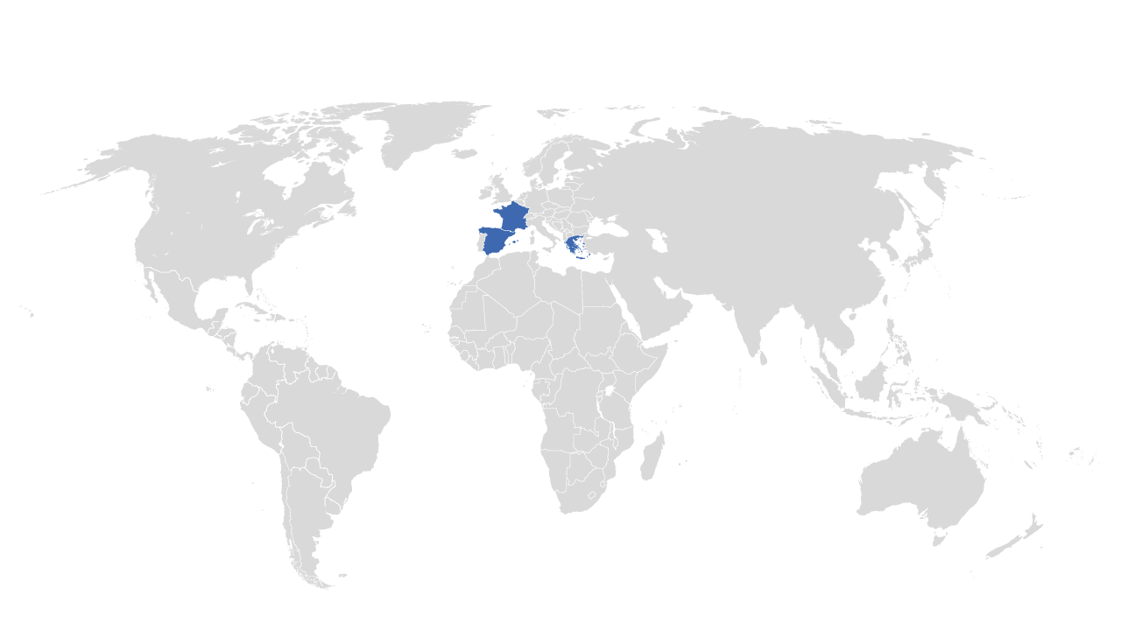
Hidden cost 2 – Which country?
Social security costs are roughly an additional 44% of the employee’s gross earnings (therefore if your employee earns $150k per annum this will result in an additional employer cost of $66k to cover Employer social security contributions)
France
Spain
Greece
Notes:
France

Slide 75
Hidden cost 2 – Which country?
Social security costs are roughly an additional 44% of the employee’s gross earnings (therefore if your employee earns $150k per annum this will result in an additional employer cost of $66k to cover Employer social security contributions)
France
Spain
Greece
Notes:
France

Slide 76
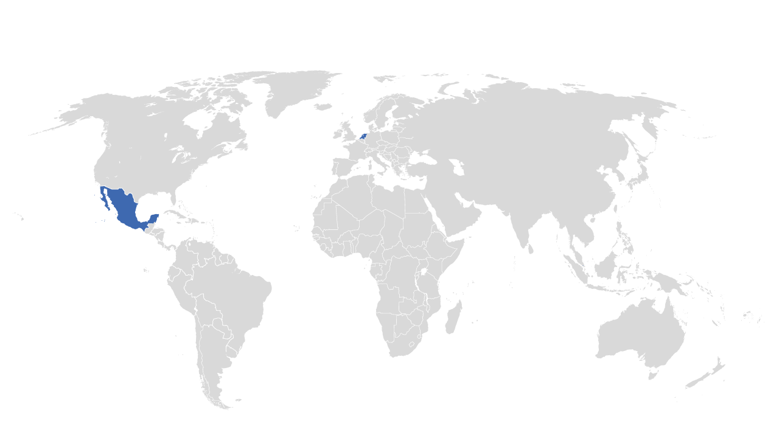
Hidden cost 3 – Which country?
An employer must implement a profit share scheme for their employees
Netherlands
Mexico
Singapore
Notes:
Mexico

Slide 77
Hidden cost 3 – Which country?
An employer must implement a profit share scheme for their employees
Netherlands
Mexico
Singapore
Notes:
Mexico

Slide 78
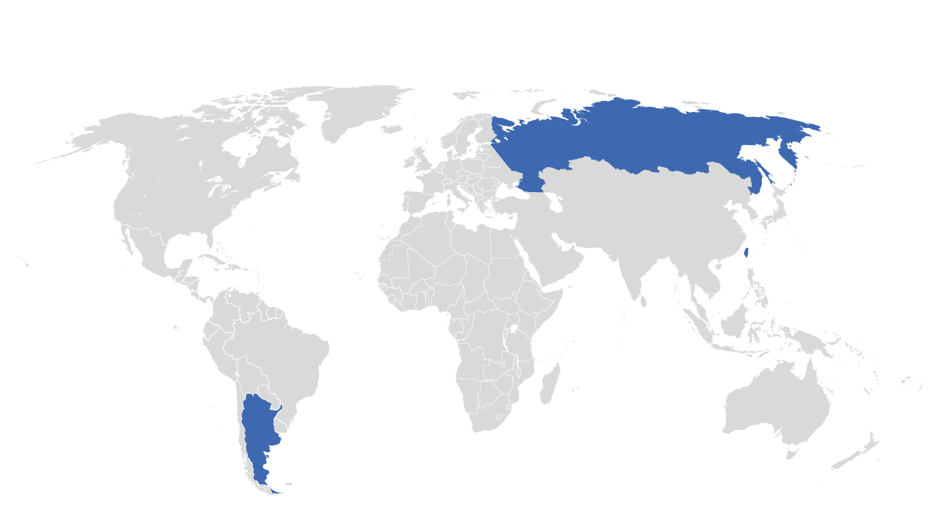
Hidden cost 4 – Which country?
Life insurance must be implemented
Russia
Taiwan
Argentina
Notes:
Argentina

Slide 79
Hidden cost 4 – Which country?
Life insurance must be implemented
Russia
Taiwan
Argentina
Notes:
Argentina

Slide 80
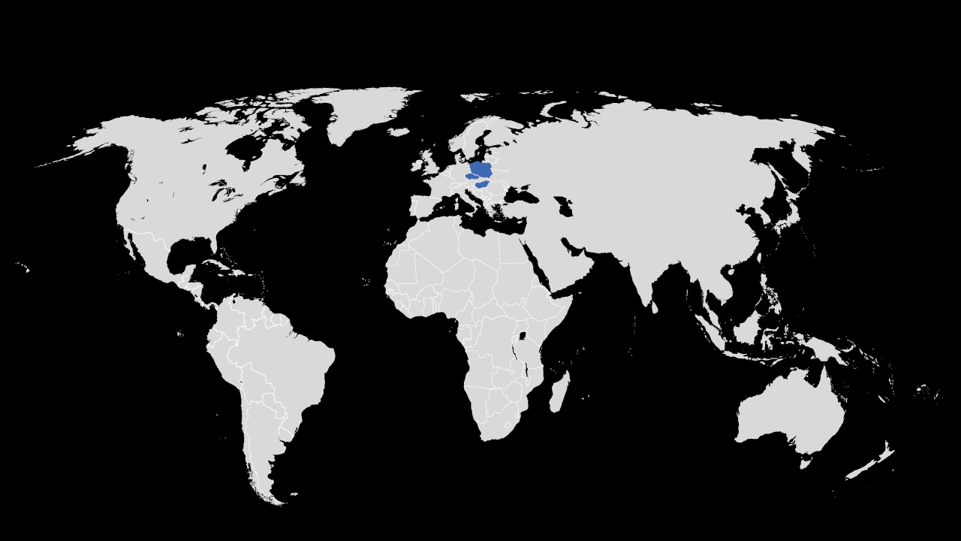
Hidden cost 5 – Which country?
Local rules on annual leave pushes up costs. 3 children means you have an extra 7 days leave per year – an initiative which may address the regions plummeting birth rate.
Hungary
Poland
Czech Republic
Notes:
Hungary

Slide 81
Hidden cost 5 – Which country?
Local rules on annual leave pushes up costs. 3 children means you have an extra 7 days leave per year – an initiative which may address the regions plummeting birth rate.
Hungary
Poland
Czech Republic
Notes:
Hungary

Slide 82

Hidden cost 6 – Which country?
Employees purposely seek out small US companies as their next employer for the simple reason that by the time their poor performance has been picked up by HQ in the US, they have already completed their probationary period. This means they will have gained enough service to have secured Unfair Dismissal Rights. At this point a termination will guarantee the employee a sizeable settlement or court award.
France
Netherlands
Many countries
Notes:
Many countries

Slide 83
Hidden cost 7 – Which country?
Employees purposely seek out small US companies as their next employer for the simple reason that by the time their poor performance has been picked up by HQ in the US, they have already completed their probationary period. This means they will have gained enough service to have secured Unfair Dismissal Rights. At this point a termination will guarantee the employee a sizeable settlement or court award.
France
Netherlands
Many countries
Notes:
Many countries

Slide 84
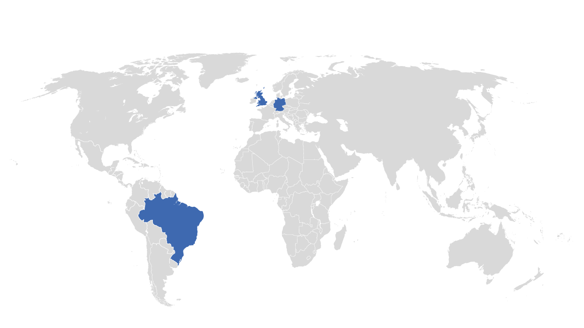
Hidden cost 7 – Which country?
Highest paid executives and senior managers in the world out ranking not only E7 countries but also all G7 countries being approximately 30% higher than the US. (plus ER social security contributions are calculated on uncapped earnings and therefore the real costs can be over 50% higher)
Germany
UK
Brazil
Notes:
Brazil

Slide 85
Hidden cost 7 – Which country?
Highest paid executives and senior managers in the world out ranking not only E7 countries but also all G7 countries being approximately 30% higher than the US. (plus ER social security contributions are calculated on uncapped earnings and therefore the real costs can be over 50% higher)
Germany
UK
Brazil
Notes:
Brazil

Slide 86
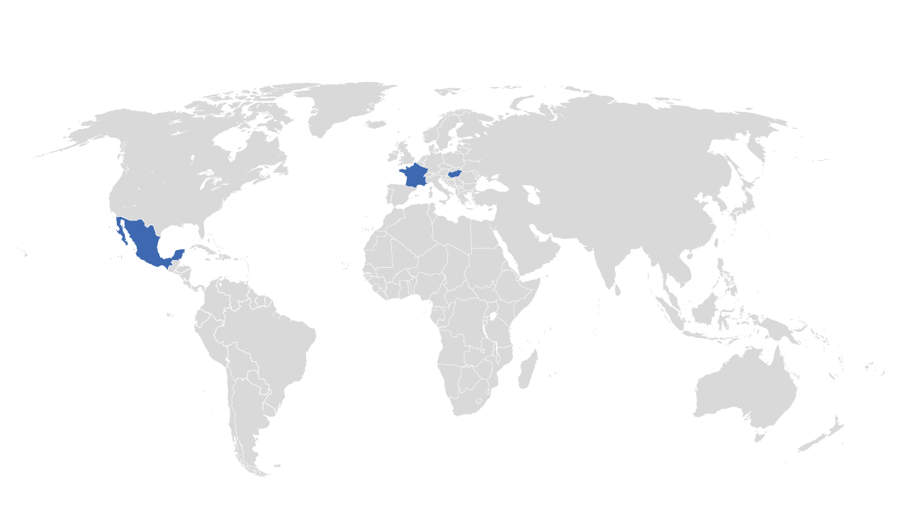
Hidden cost 8 – Which country?
25 days vacation per annum but there are also concepts such as ‘time savings accounts’’ where overtime and holiday can be banked.
Hungary
Mexico
France
Notes:
France

Slide 87
Hidden cost 8 – Which country?
25 days vacation per annum but there are also concepts such as ‘time savings accounts’’ where overtime and holiday can be banked.
Hungary
Mexico
France
Notes:
France

Slide 88
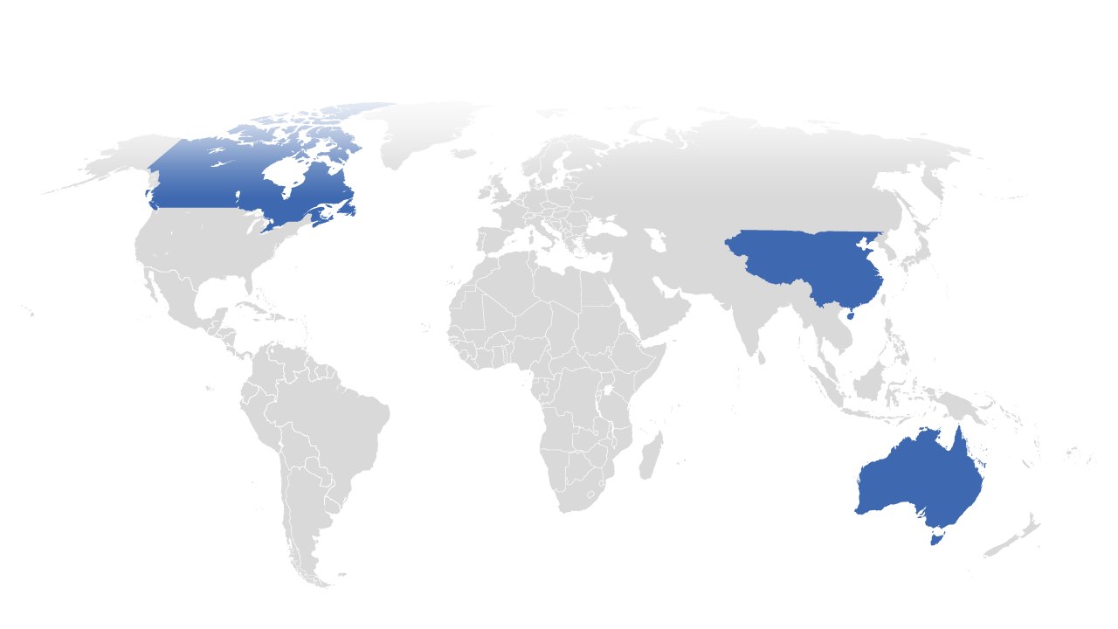
Hidden cost 9 – Which country?
Modern Awards system of collective agreements linked to vocation rather than the employer’s business sector therefore your IT technicians, office administrators, teaching staff and sales personnel will all operate under separate agreements. The prescribed grading hierarchies requiring minimum salary and benefits kills any chance of harmonization with other countries
Canada
China
Australia
Notes:
Australia

Slide 89
Hidden cost 9 – Which country?
Modern Awards system of collective agreements linked to vocation rather than the employer’s business sector therefore your IT technicians, office administrators, teaching staff and sales personnel will all operate under separate agreements. The prescribed grading hierarchies requiring minimum salary and benefits kills any chance of harmonization with other countries
Canada
China
Australia
Notes:
Australia

Slide 90
Survey question 10 – global Opportunities ?
Which of the following do your HR colleagues view as the top opportunity for global expansion?
a) Europe
b) Latin America
c) China
d) Other
e) India

Slide 91
Which of the following did Radius clients view as the top opportunity for global expansion
Europe 40%
Latin America 23%
China 21%
Other 12%
India 5%

Slide 92
recap
Company Structure
& Tax
Overseas Payroll / HR Frameworks
Budgeting for Payroll / HR Costs
Winning Globally

Slide 93
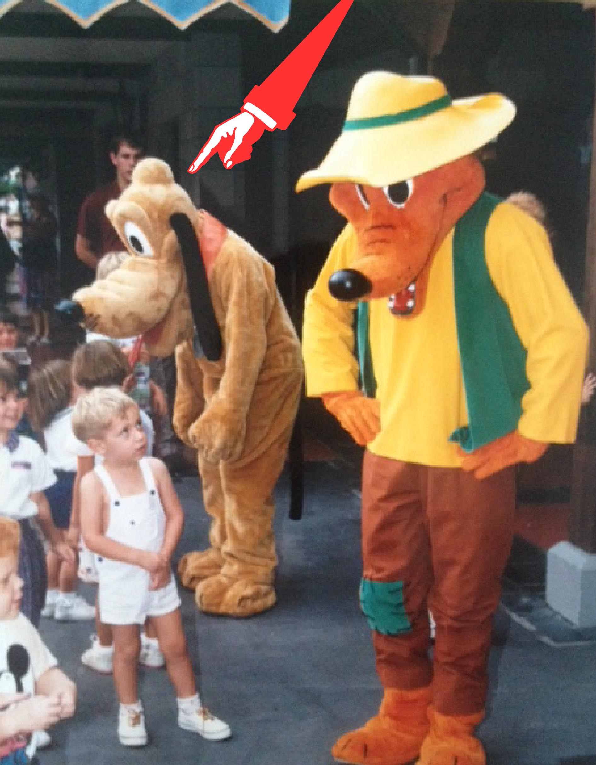
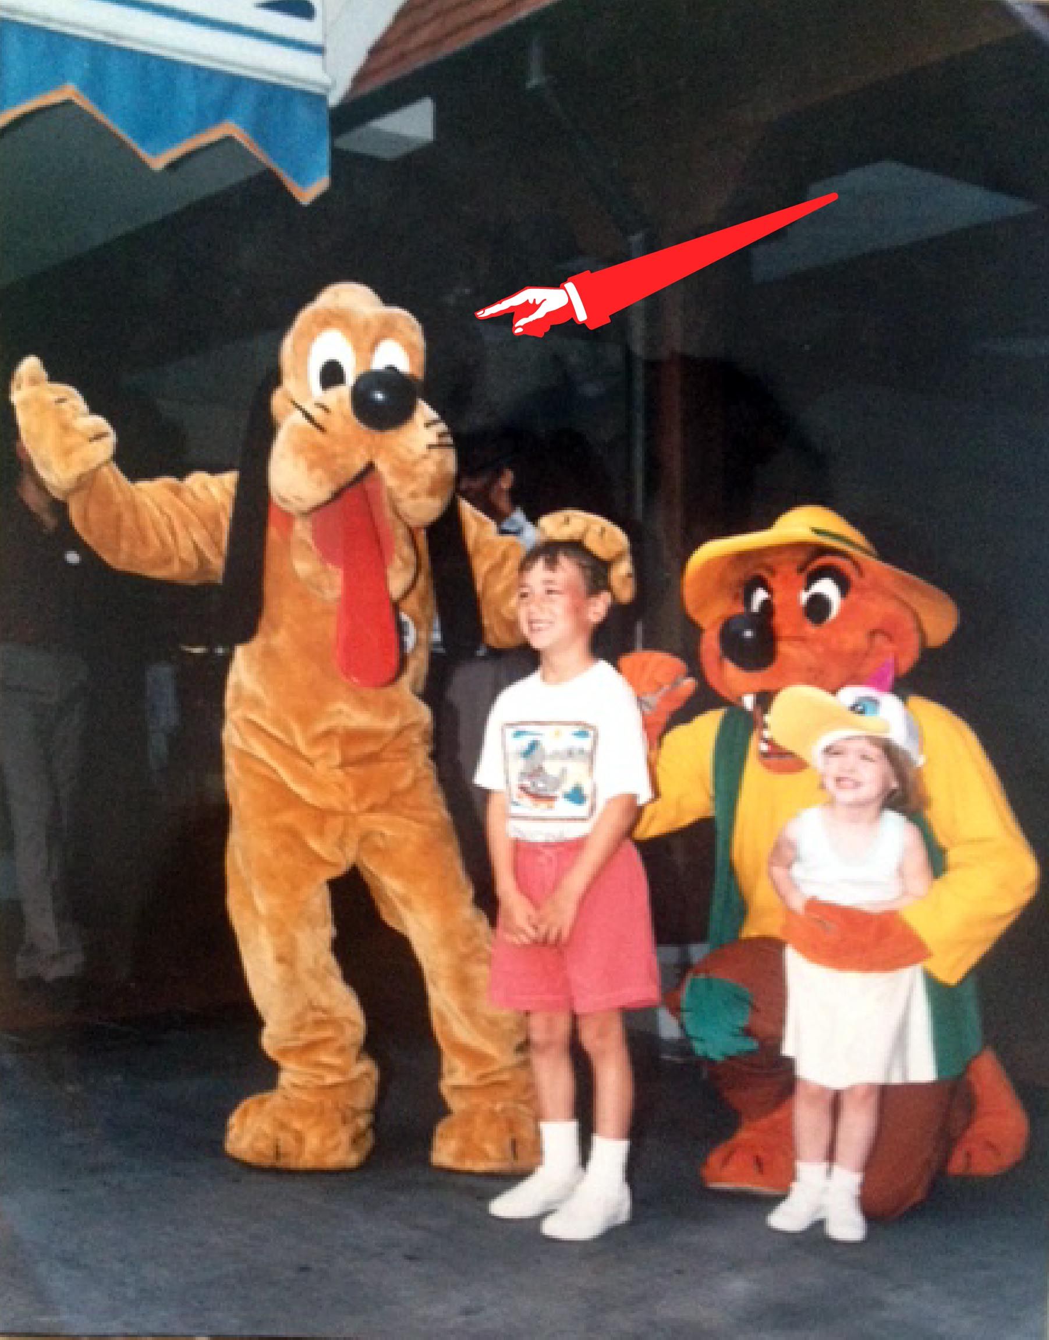
Claim to Fame: pluto for a day

Slide 94
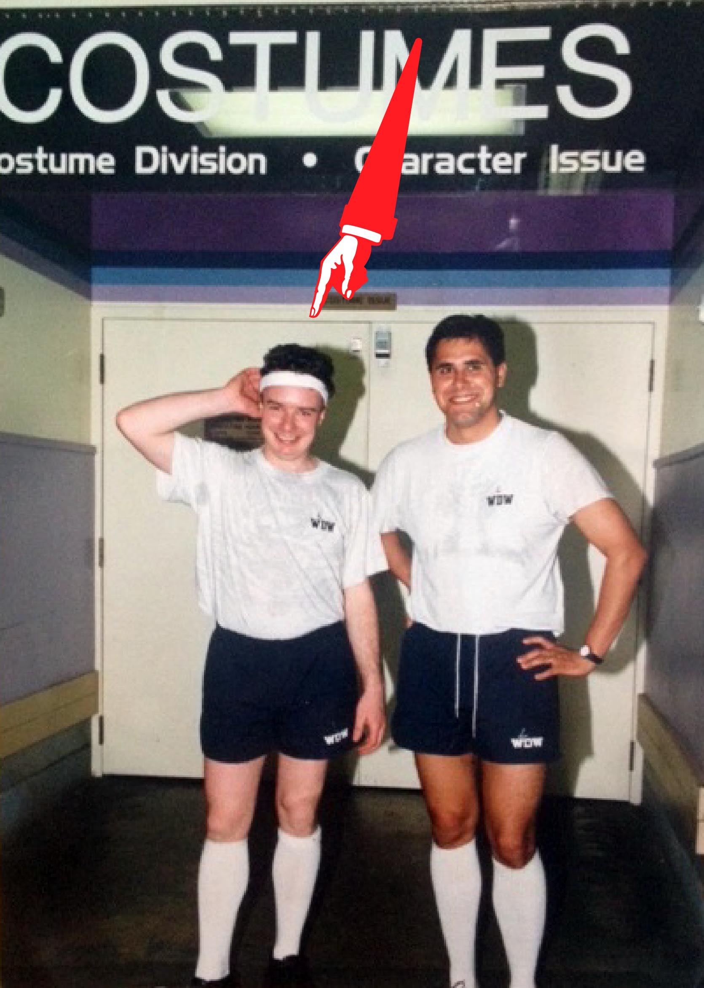
Proof – costume department

Slide 95
When it is all going well …..

Slide 96

Don’t steal their dream…..

Slide 97

Don’t steal their dream…..

